Slide 1
Oracle Hyperion Cloud
Access:
PennKey (and PennKey password) to login. PLEASE USE FIREFOX!
Access Hyperion Cloud via the Planning Application section of the Budget Office website. Select “PennPlan Login” from the red box on the left side. And if prompted, please note that our Identity Domain is a183374.
www.budget.upenn.edu
Budget Entry:
In some cases, particularly with Current Expense, Object Codes that appear in BEN are consolidated in Oracle Cloud.
http://www.budget.upenn.edu/dlDocs/RCM_template_1A.pdf
Reporting:
Several useful reports (please contact F&A with any questions):
A7-Account Detail-Non-Compensation
A8-Account Detail-Compensation
B14-Endowment & Gift Fund Analysis
X46-WHA-RCM Row and Object Detail-No Rounding
Instant updates from budget entry to reporting output!

Slide 2
Web Browsers for the Cloud / Access for NEW USERS
Firefox is compatible with Hyperion Cloud (Preferred Browser)
Internet Explorer 11 is compatible with Hyperion Cloud
Access for NEW USERS:
If you are a NEW USER and do not currently have access to Oracle Hyperion, please visit the
Budget Office website here:
http://www.budget.upenn.edu/Planning_Application/Support/Documentation/New_User_Setup/
Please select the link to view and print the planning access form and please contact your F&A analyst.
Notes:
2

Slide 3
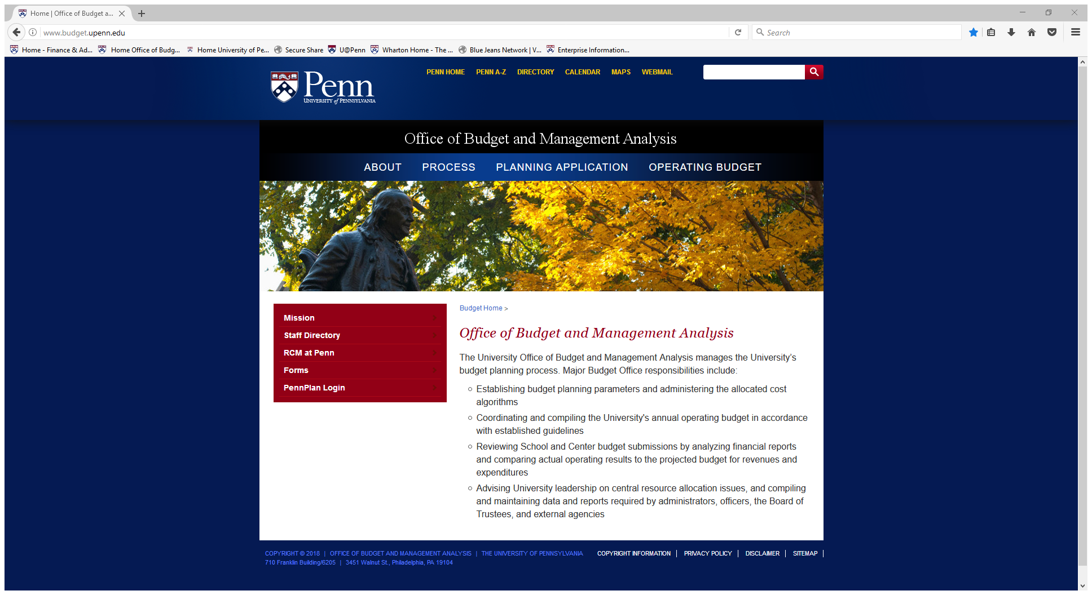
Access Hyperion Cloud and Reports
Go to: www.budget.upenn.edu
Click “PennPlan Login”
Notes:
Once your browser settings are correct, we can now log into Hyperion.
Start at www.budget,upenn.edu. Bookmark this page.
This how we get into Hyperion.
And click on “Budget Planning Tools.”

Slide 4
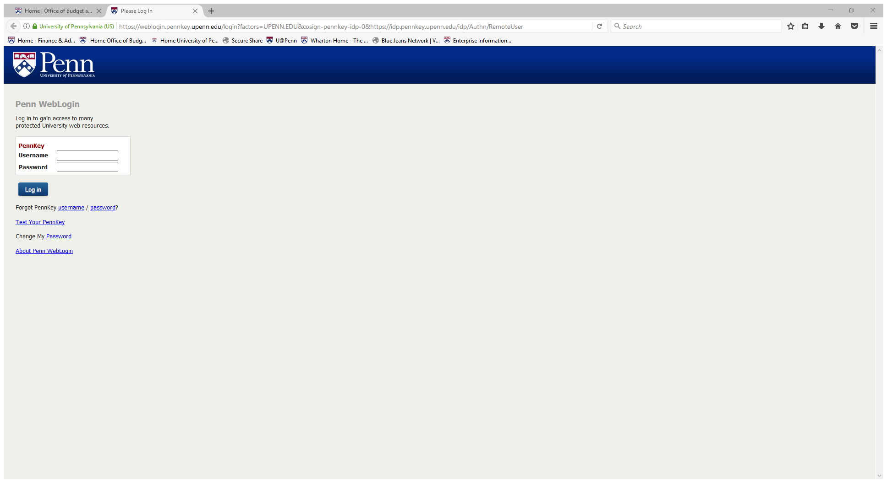
Login with PennKey

Slide 5
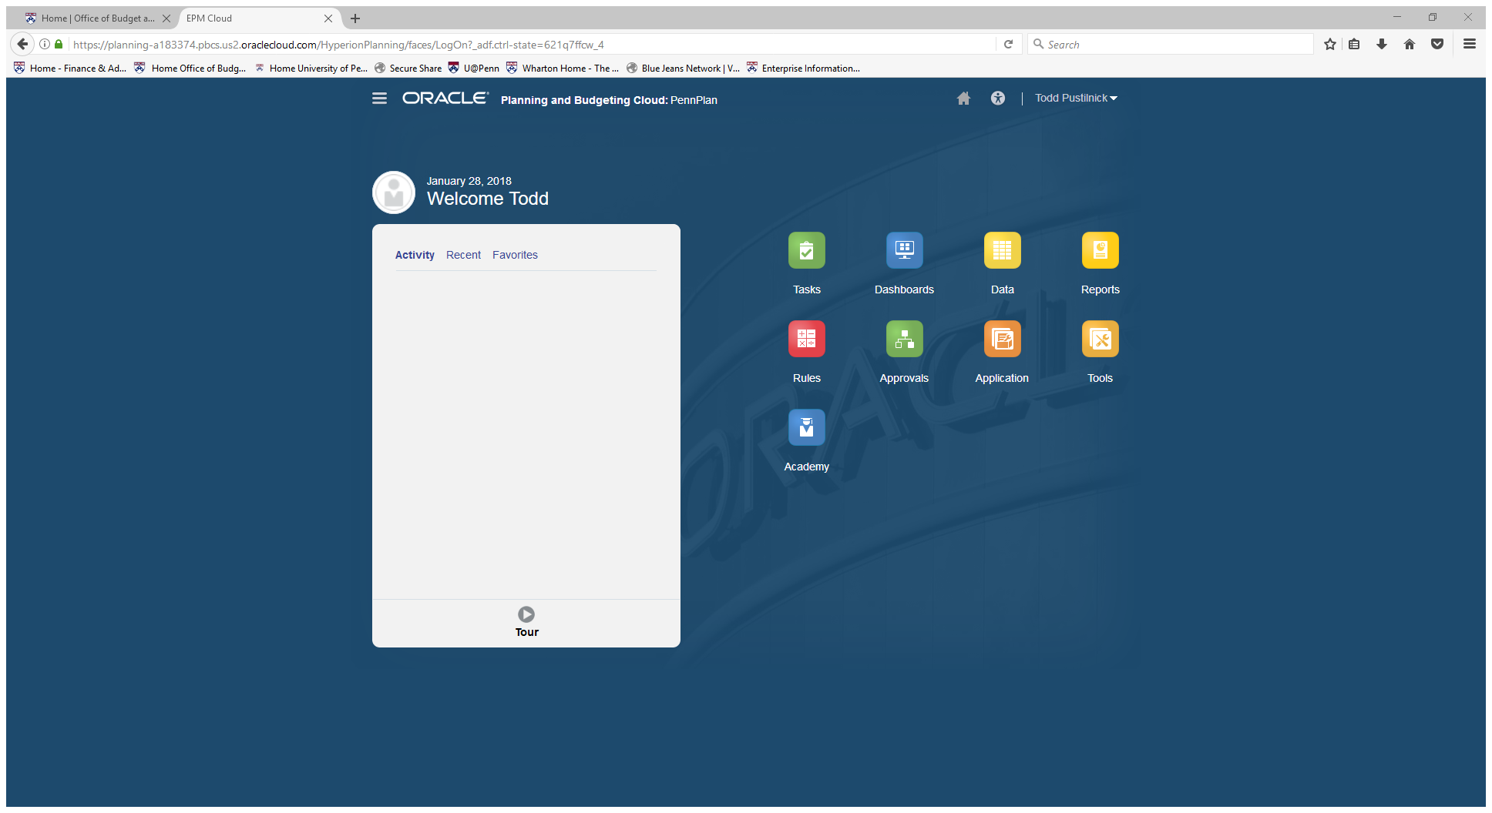
Hyperion Cloud | Homepage

Slide 6
Hyperion Cloud | Homepage
Budget Entry here
Check/Update USER VARIABLES here

Slide 7
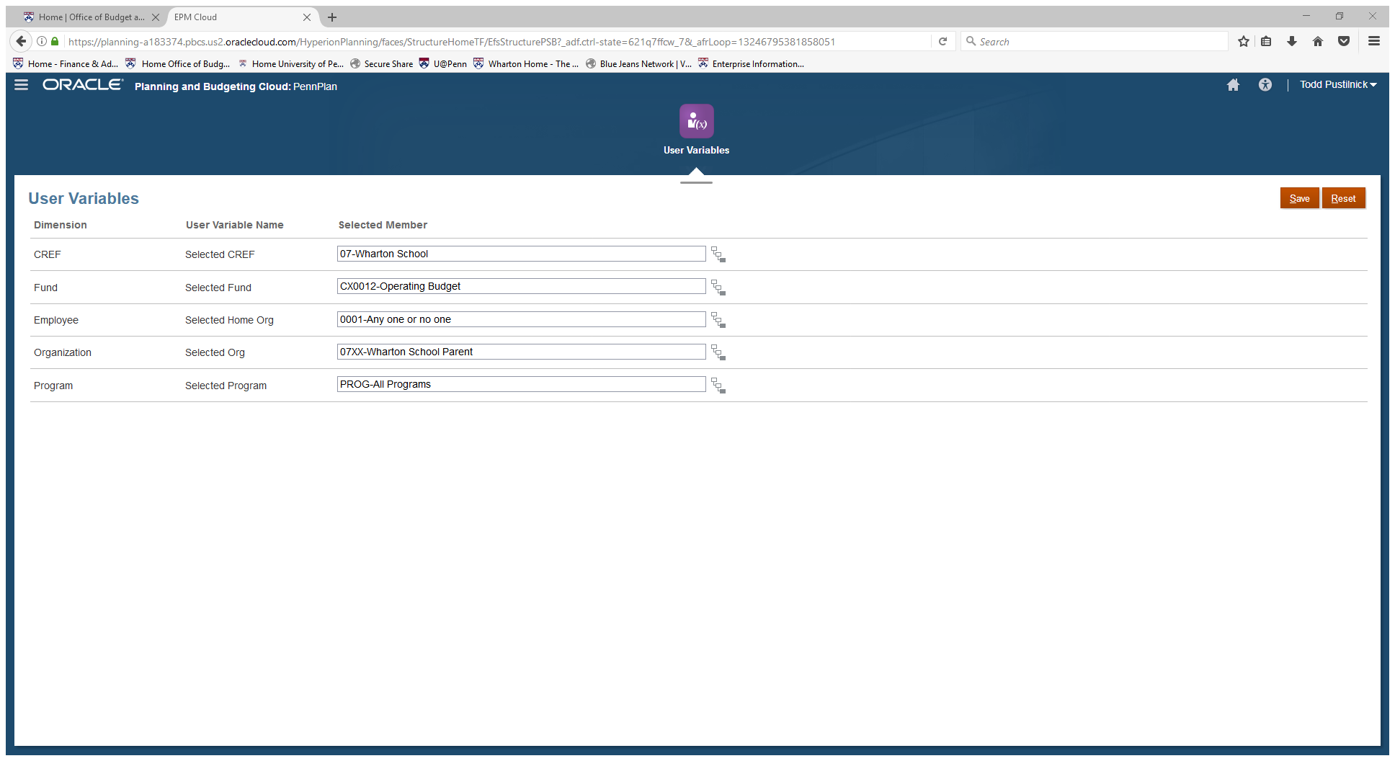
Hyperion Cloud | User Variables
“Organization” selection may be different based upon your system access and area of responsibility.
Check user preferences here

